Slide 1
MatFormer: Nested Transformer for Elastic Inference
Prateek Jain
Google Research India
Devvrit, Sneha Kudugunta, Aditya Kusupati,
Tim Dettmers, Hannaneh Hajishirzi, Yulia Tsvetkov, Kaifeng Chen, Inderjit Dhillon,
Sham Kakade, Ali Farhadi
Notes:
Thanks XX for the generous introduction and for having me here. And thank you all for attending the talk.
Today I will discuss our work on matformers which is hot out of oven
This project has been a joint collaboration between multiple amazing folks from google and UW.
In particular, Devvrit, Sneha, and Aditya have done all the hard work, and deserve all the credit for key ideas, implementation and empirical evaluation.

Slide 2
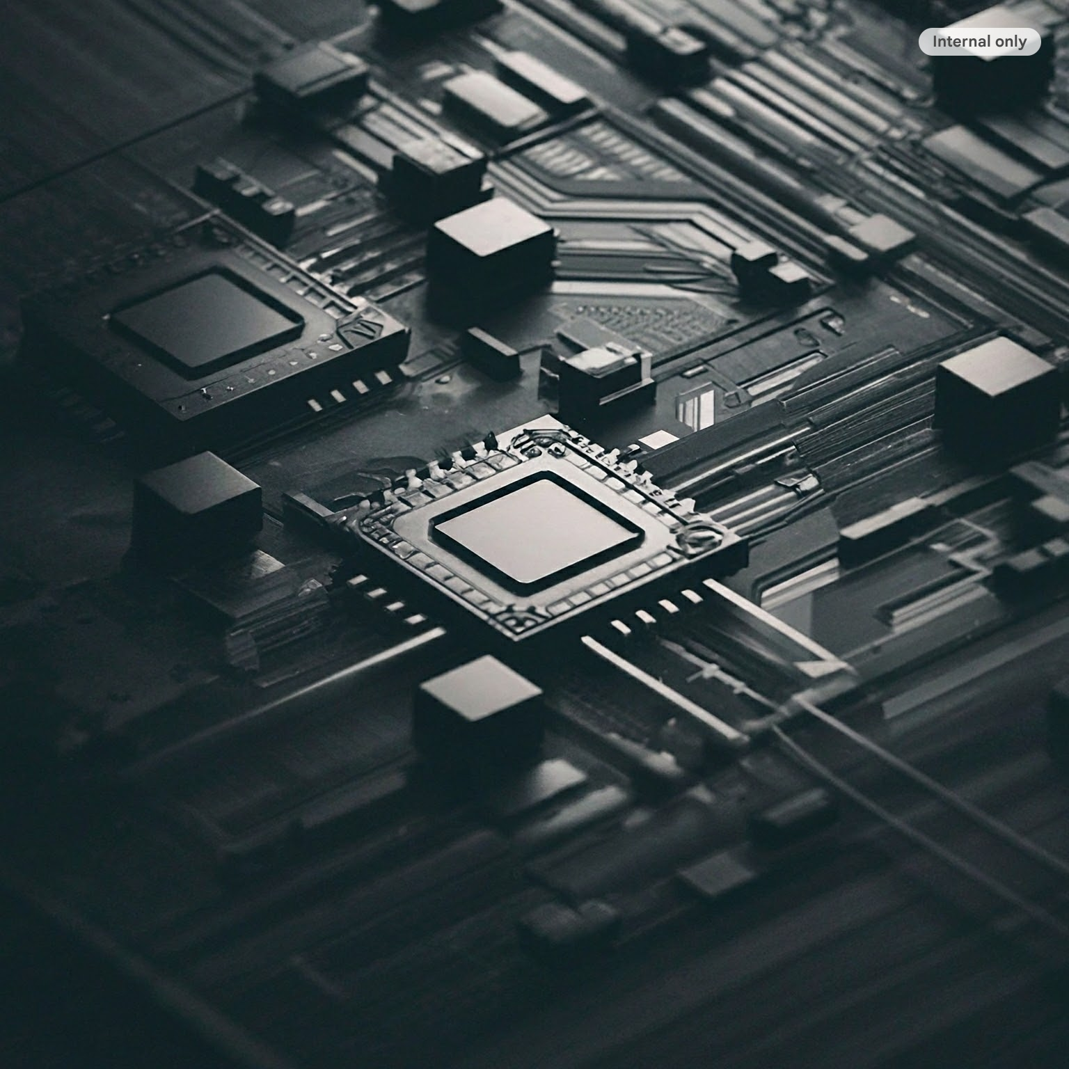
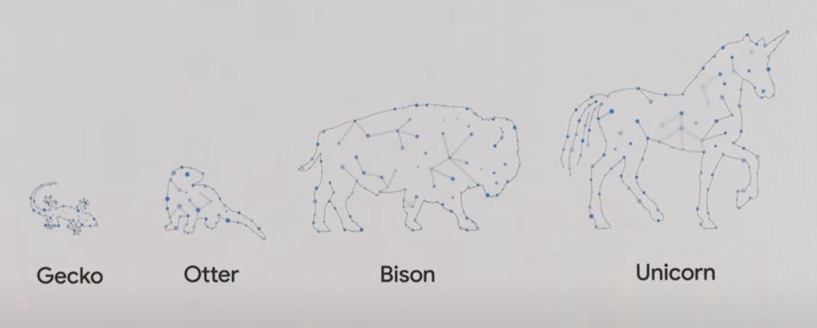
Large Models: Deployment Story
Typically only a few models to choose from
Might have to select say Llama 13B even if capacity for Llama 40B
Distillation/pruning requires additional training
Deployment Constraints
(RAM, Latency, QPS…)
Goal: design a “universal” model from which hundreds of accurate models can be extracted
PALM 2
Notes:
This is not a news to this audience that foundational large models are super successful in a variety of domains, and are seeing deployment in a wide array of settings like in cloud, mobile, tablets, and similarly in real-time settings, in batch-mode settings etc.
So based on the application and the underlying system, we can come up with a bunch of deployment constraints like what kind of RAM utilization be supported, how much latency can be tolerated etc. Currently we select the largest and most accurate model that meets those criteria.

Slide 3
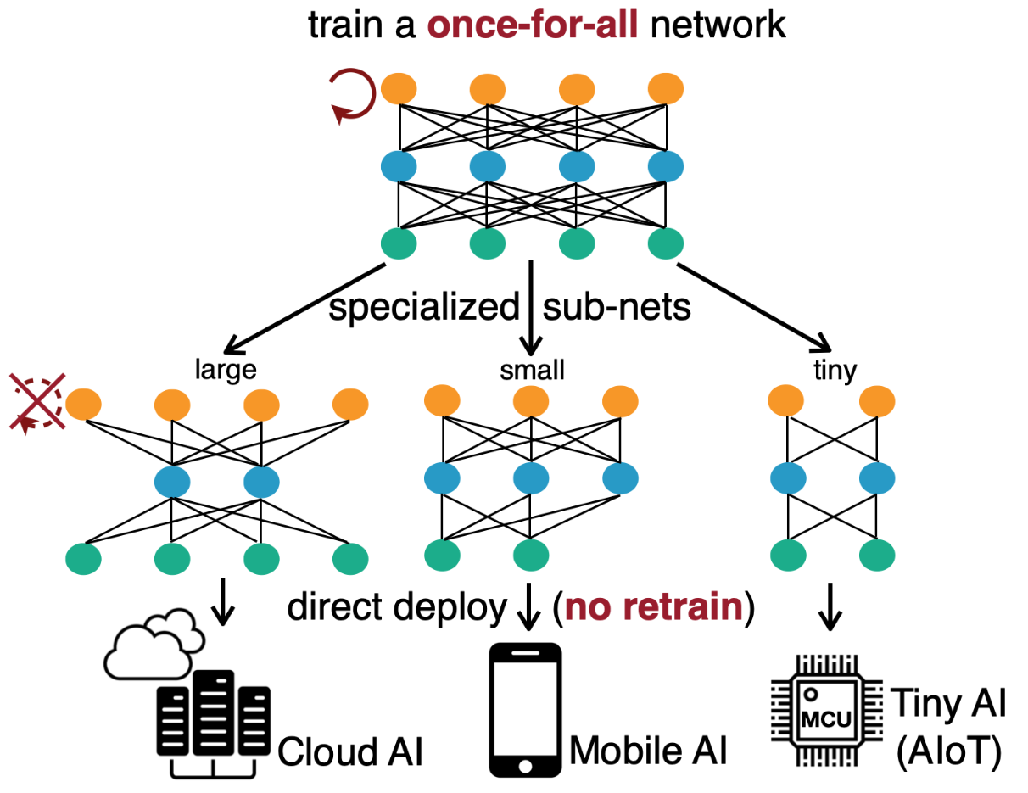
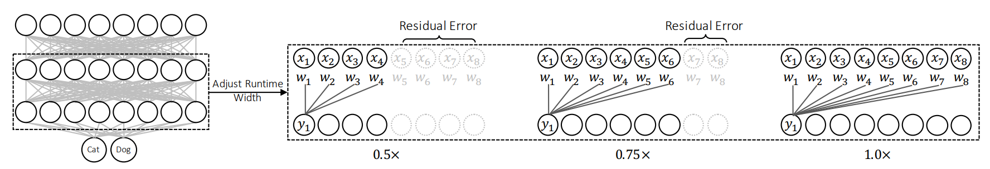
Existing Solutions towards MatFormer
(Universal) Slimmable Networks (Yu & Huang ICLR 2019; ICCV 2019)
Primarily focused on CNNs
Training routines w/
Modifications to batchnorm
Sampled submodels
Distillation from largest model
Longer/costlier training routines
Once-for-All (Cai et al., ICLR 2020)
Notes:
Coputer vision community has been leading the path on this front for past 3-4 years with very interesting techniques like slimmable networks and once-for-all networks. However, typically these models are more focused on CNNs while we want to target transformer kind of architectures. But more crucially the training routines samples submodels and updates parameters with those, which tends to give more costly training routine.

Slide 4
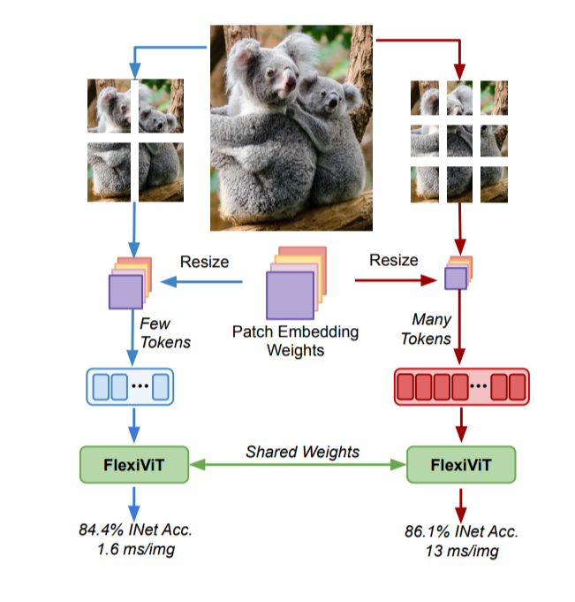
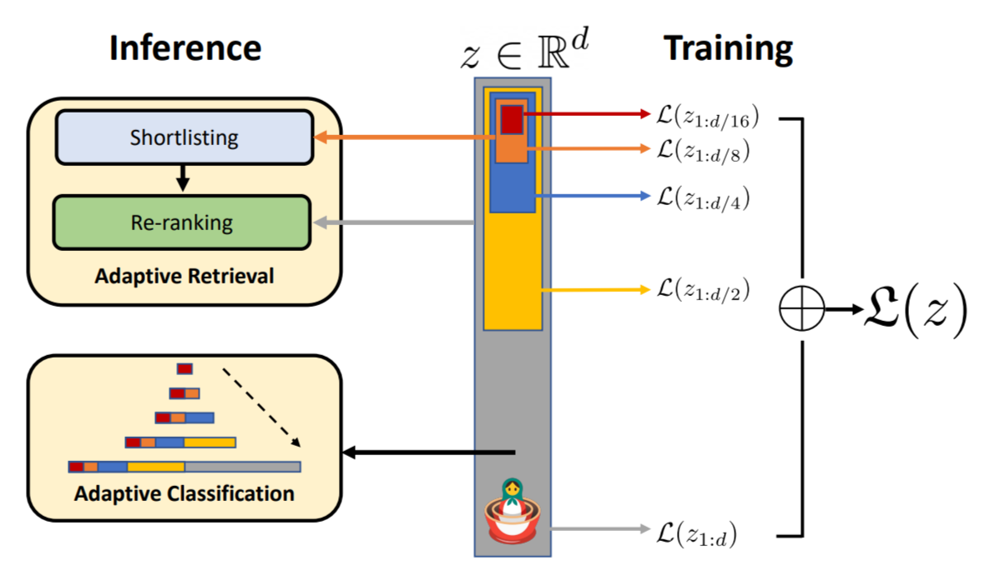
Existing Solutions towards MatFormer
Matryoshka Representation Learning (Kusupati et al., NeurIPS 2022)
FlexiViT (Beyer et al., CVPR 2023)
Flexibility in output and input space respectively
Notes:
In parallel, there has been work on making the output embedding of a model or the input to be flexible, which is complementary to what we are doing.

Slide 5
MatFormer: Nested Substructure
Works for Transformers – without modifications to fundamental blocks
Joint training: No subsampling or distillation
Significantly cheaper training cost that equivalent methods while being more accurate
4 granularities sufficient to span a wide range of constraints.
Notes:
The main idea behind our matformer is to design a nested substructure and training routine such that it works fro transfoemrs, training goes away from subsampling kind of ideas and relies on what we call joint optimization, and can scales to billions of parameters, with really compelling results.

Slide 6
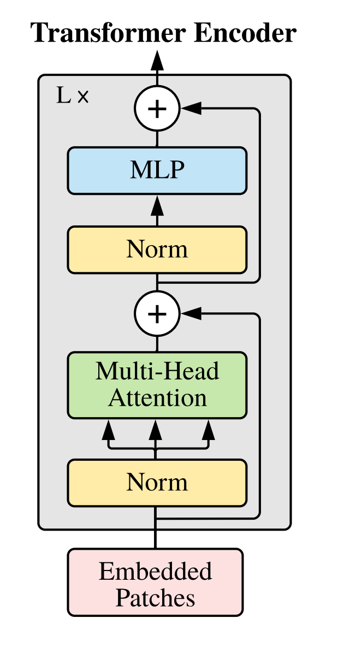
Transformer
MLP
ℝ^{d}
W₂∈ℝ^{h✕d}
MLP: ~80% of the cost
Attention: ~20% of the cost
𝞼 (
)
ℝ^{h}
W₁∈ℝ^{d✕h}
ℝ^{d}
h = 4*d to 12*d typically
Notes:
So with this context, lets dive deeper into matformers. For that lets first start with the transformer block. You would have seen this picture many times earlier. In this block we have two key parts…

Slide 7

MatFormer: Matryoshka Transformer
MatFormer builds upon MRL
Apply MRL to MLP layer in each transformer block
L+1-th layer token x
Model-M
W₂
Model-L
W₁
Model-XL
Model-S
L-th layer token x
That is, neurons are nested in each other.

Slide 8
MatFormer: Generality & Training
Recipe:
Pick XL model architecture
Pick G granularities for nesting eg., G = 4
Jointly optimize G shared models akin to MRL
Matformer train cost < total cost of training each granularity from scratch
MatFormer can also be induced w/ Fine-tuning
MLP hidden representation
Attention
Model input representation
Applicable to all Transformers components
Can generate 1000s of models not just 4

Slide 9
Mix'n'Match & Routing on MatFormer
Transformer Block 1
Transformer Block 2
Transformer Block 3
Transformer Block 4
Transformer Block 5
Transformer Block 6
MatFormers

Slide 10
Mix'n'Match & Routing on MatFormer
Transformer Block 1
Transformer Block 2
Transformer Block 3
Transformer Block 4
Transformer Block 5
Transformer Block 6
MatFormers
This gives only say 4 models.
So where do we get 1000s of models???

Slide 11
Mix'n'Match & Routing on MatFormer
Model-M
Transformer Block 1
Transformer Block 2
Transformer Block 3
Transformer Block 4
Transformer Block 5
Transformer Block 6
Model-S
Mix’n’Match: 100s (combinatorial) of static (on-demand) models for all accuracy-compute
Routing: Token based routing akin to MoE to realize dynamic computation

Slide 12
MatLM: MatFormers for Language Modeling
Standard setting from Lamda (Thoppilan et al.)
G = 4 granularities – change the MLP hidden dims!
XL – hidden_dim (hd), L – hd/2, M – hd/4, S – hd/8.
Nomenclature: MatFormer-XL, MatFormer-L, MatFormer-M, MatFormer-S
Independently Trained Models: Baseline-XL, Baseline-L, Baseline-M, Baseline-S
7 different “XL” model scales: from 78M up to 2.6B parameters.
78M, 180M, 310M, 463M, 850M, 1.3B, 2.6B

Slide 13
MatLM: Key Findings
Little to no loss in test pplx and GPT3 1-shot downstream evals.
For each granularity, i.e., accuracy(MatFormer-Z) ~ accuracy(Baseline-Z)
Z ∊ [XL, L, M, S]
Able to read models for free using Mix’n’Match
Mix’n’Match interpolates well between the 4 granularities
Side effects: consistency with large model, gains over Speculative Decoding

Slide 14
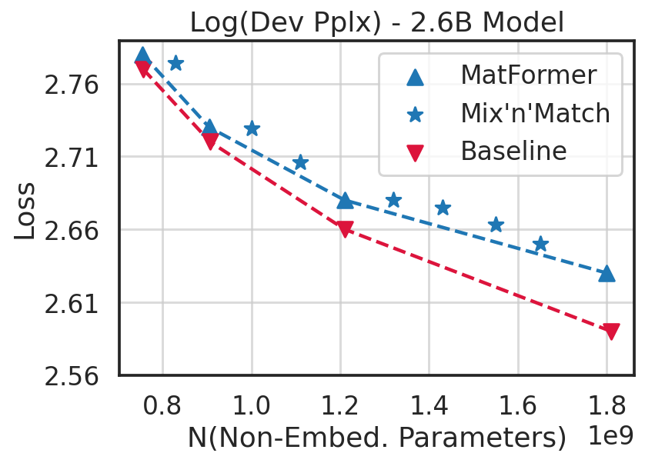
Language Modeling with 2.6B model: Mix’n’Match
Trained for: 160B tokens
Decoder-only model w/ same hparameters for baseline & MatFormer
XL model size: 2.6B
We read-off L, M, S models for matformer
Baselines trained from scratch for all granularities
Log pplx within 0.04 of the baseline for 2.6B model!
Downstream evals almost match (see next slide)
All the ★ are for “free” – they were never trained for
We just read them from Matformer-XL
~0.04

Slide 15
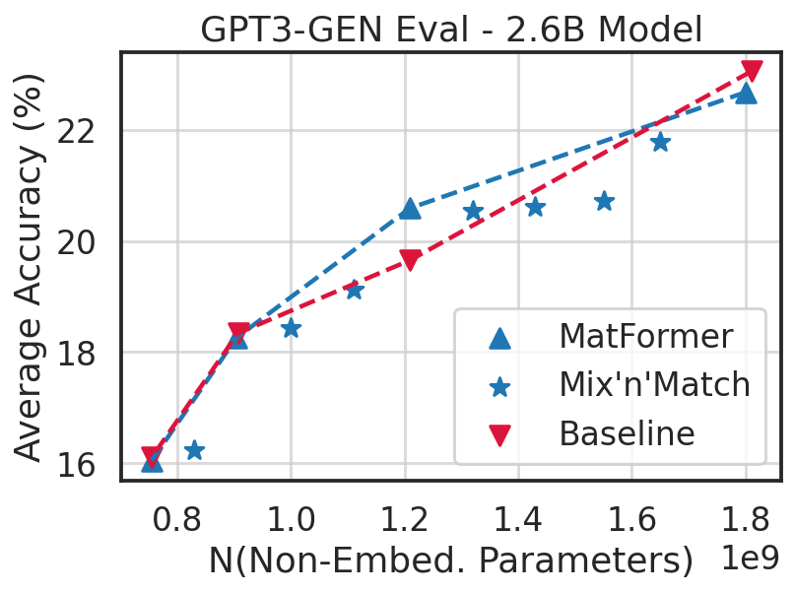
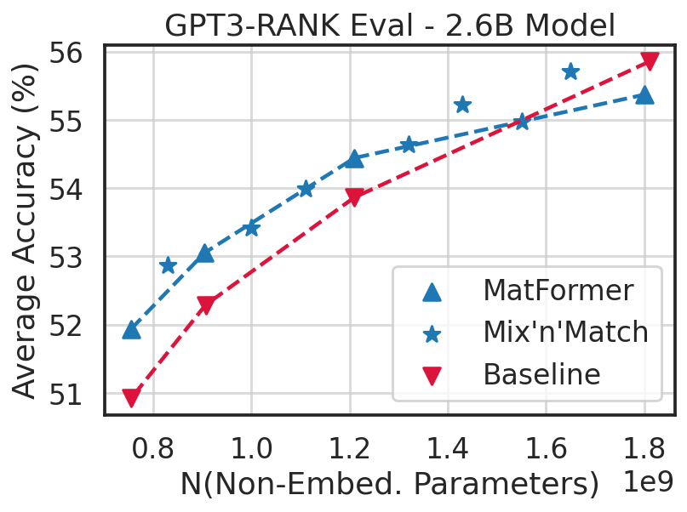
Language Modeling with 2.6B model: Mix’n’Match
1-shot GPT-evals
Almost matching accuracy for MatFormer–[XL, L, M, S] models against Baselines
We get all the intermediate models denotes by ★ for “free”
No extra training!
For GPT-3 Rank: ★ models almost lie on a line interpolating trained MatFormer models (XL, L, M, S)

Slide 16
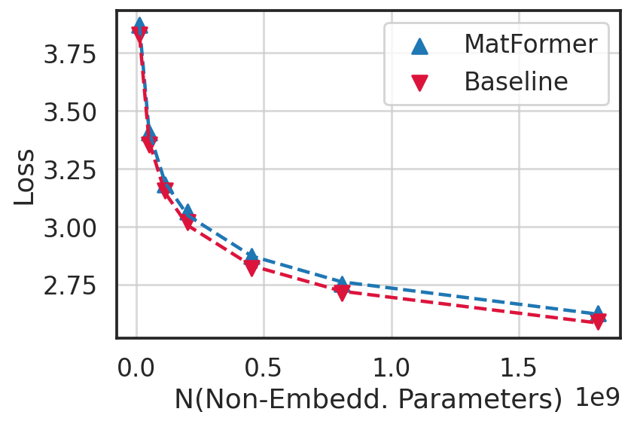
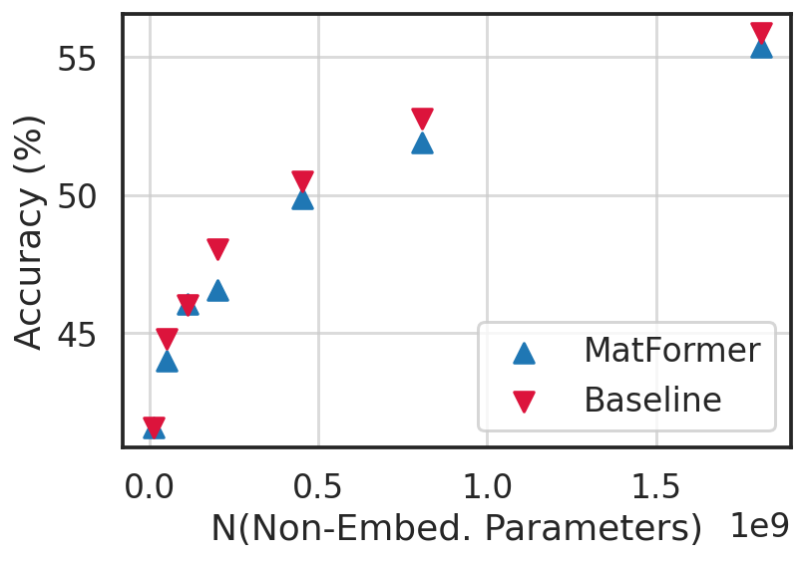
Language Modeling: Scaling Plots for Universal Model (XL)
MatFormer : 23.0528 * N ^ -0.1407 + 1 / D + 1.4352 Baseline : 22.7879 * N ^ -0.1414 + 1 / D + 1.4973
Where N = N(Non-Embedding Parameters) and D = N(Training Tokens)
Above laws hold for all trained granularities: XL, L, M, S!
Notes:
https://colab.corp.google.com/drive/1sCmpnIQ1RnJdgrGrbMgsGUbaTfoxUhe5#scrollTo=RO0i9IZB4W-7
Matformers: 23.0528 * N ^ 0.1407 + 1 / D + 1.4352
Baseline : 22.7879 * N ^ 0.1414 + 1 / D + 1.4973
N: param count; D: N(Tokens)

Slide 17
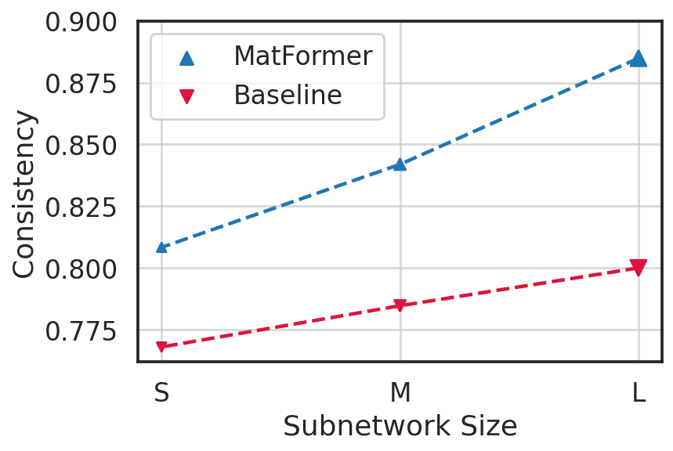
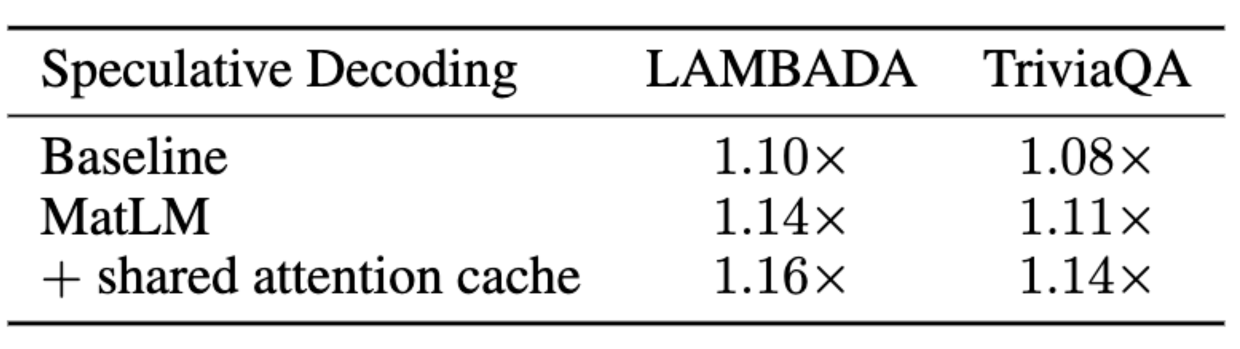
Language Modeling: Consistency for 2.6B XL model
Consistency: accuracy of smaller models (S, M, L) when output of XL model is the ground truth
Why care about consistency? Techniques like Speculative Decoding becomes more efficient with more consistent models
MatFormer subnetworks are significantly more consistent with the full model compared to vanilla baselines.

Slide 18
MatViT: MatFormer + ViT
Generalized formulation translating to ViT
Works for across model sizes for both pre-training and fine-tuning
Enables accurate adaptive encoders for classification
Spans all of the space with Mix’n’Match (and potentially routing)
Enables accurate adaptive query encoders for retrieval
Use the largest model for Index building
Leverage smaller query encoders during inference based on the constraints
This requires aligned training/distillation for baseline models to work

Slide 19
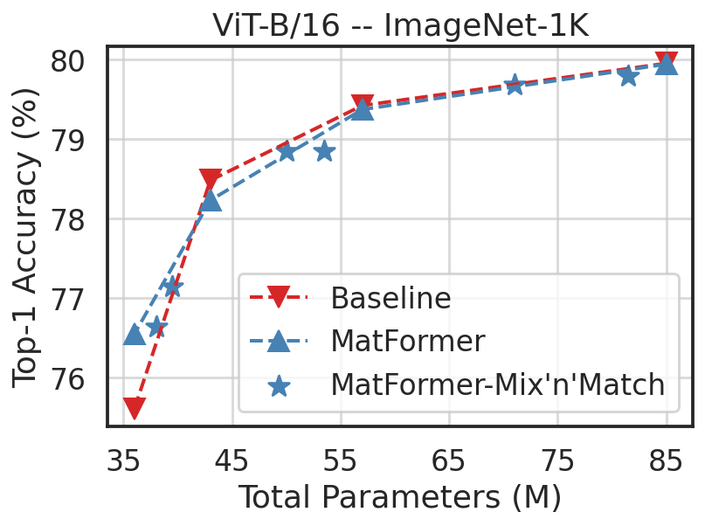
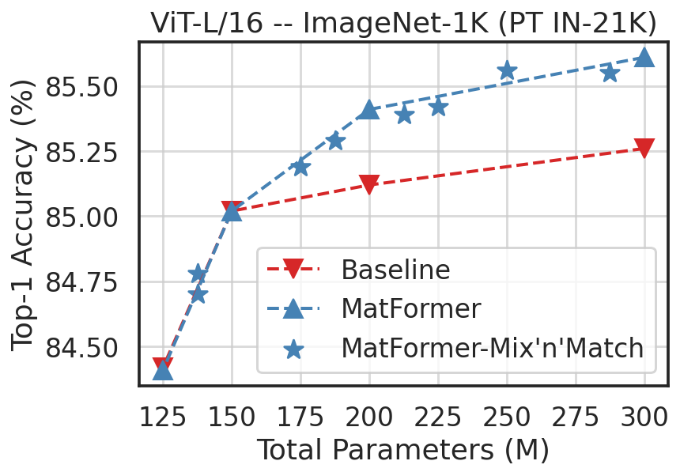
MatViT: Classification
All the ★ are for “free” during inference – they were never optimized for.

Slide 20
MatViT: MatFormers + ViT
Generalized formulation translating to ViT
Works for across model sizes for both pre-training and fine-tuning
Enables accurate adaptive encoders for classification
Spans all of the space with Mix’n’Match (and potentially routing)
Enables accurate adaptive query encoders for retrieval
Use the largest model for Index building
Leverage smaller query encoders during inference based on the constraints
This requires aligned training/distillation for baseline models to work

Slide 21
Semantic Search: Dual Encoder Models
Query Encoder
Indexer (ANNS)
query
doc6, doc172
Retrieved documents
….
Doc embeddings
Document Encoder
doc1, doc2, …., docN

Slide 22
Semantic Search: Flexible Dual Encoder Model
MatFormer
Indexer (ANNS)
query
doc6, doc172
Retrieved documents
Doc embeddings
Select model based on query load, hardness etc
….
Document Encoder
doc1, doc2, …., docN

Slide 23
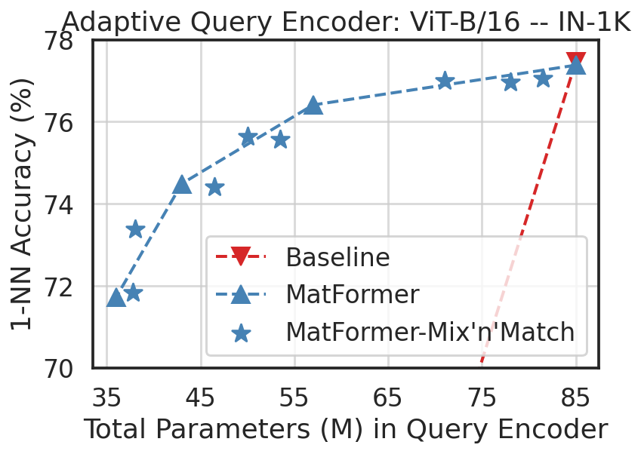
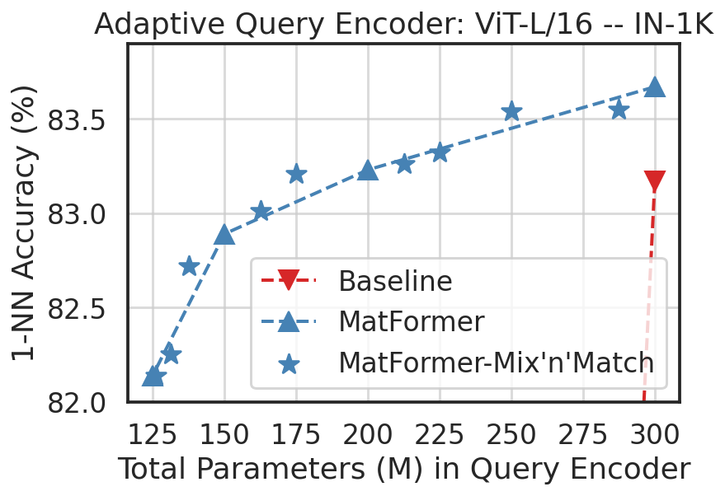
MatViT: Adaptive Retrieval (Index built w/ largest model)
All the ★ are for “free” during inference & preserve metric space.
L/16 pretrained on IN-21K

Slide 24
MatFormer + ViT-B/16: Cross-consistent Retrieval
1-NN accuracy (%) with varying index and query encoder sizes from MatViT-B/16 (Baseline numbers): Rest are near Random
Index /Query | 36M | 43M | 57M | 85M
36M | 72.42% (71.44%) | 74.31% | 75.33% | 76.26%
43M | 72.30% | 74.71% (74.90%) | 75.93% | 76.69%
57M | 72.12% | 74.71% | 76.44% (76.58%) | 77.19%
85M | 71.71% | 74.48% | 76.40% | 77.40% (77.46%)
Adaptive Query Encoders for Retrieval

Slide 25
Summary and Future Work
Matformer: nested substructure for elastic inference
Training: joint optimization of a few granularities
MatLM: Matformer Language Model
2.6B scale models with same pplx and evals as independently trained baselines
Consistency: gains over speculative decoding
MatVIT: Matformer Vision Transformer
ViT-L/16 scale models, similar performance as independently trained baselines
Adaptive retrieval
Future Work:
Further investigation of scaling laws
Better training algorithms
Practical deployment of a truly elastic system

